Slide 1
Power Consumption Analysis
Course 4 Task 2 Assignment

Slide 2
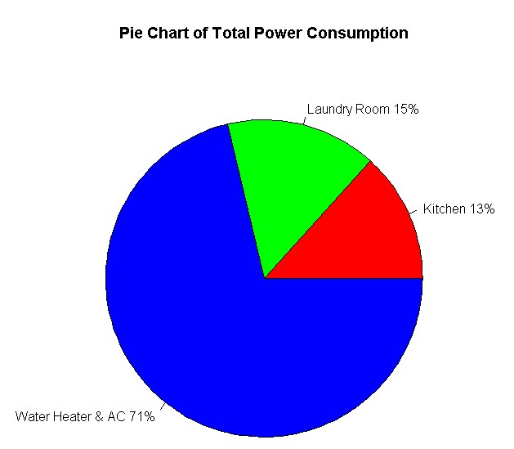
Overall Power Consumption
This graph confirms what was illustrated in our previous analysis from the kick-off meeting.
Power consumption is overwhelmingly related to temperature regulation.
In the next slide, this will be further confirmed by looking at power consumption by specific year.

Slide 3
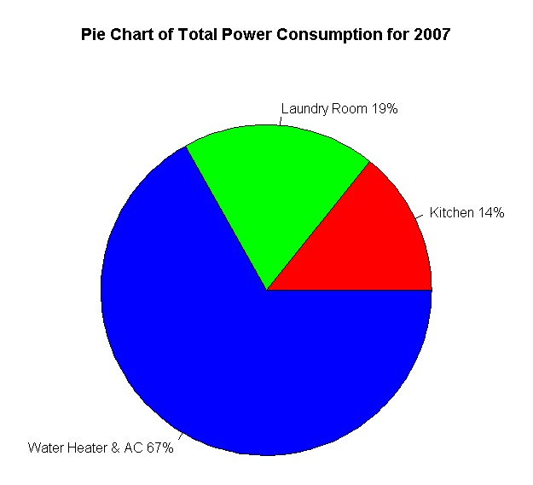
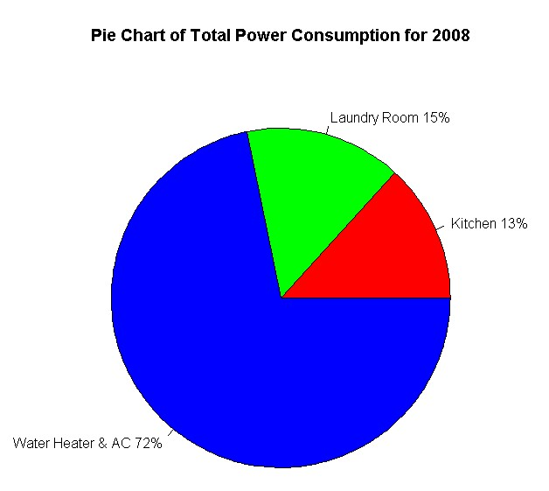
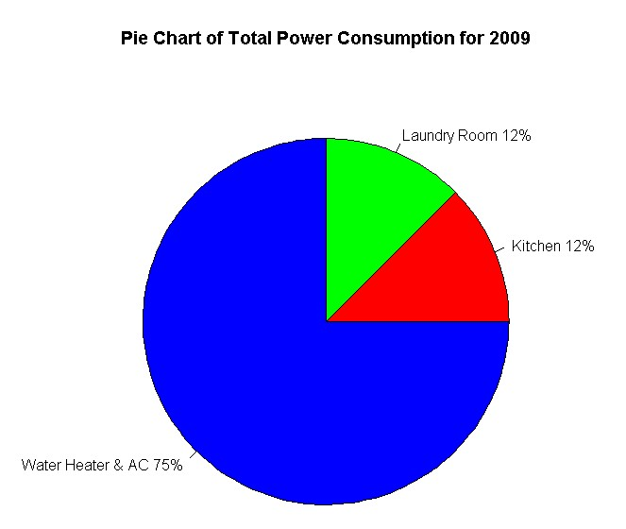
Power Consumption by Year
Regardless of year, power consumption is most related to temperature regulation.
This is especially true, as we will see in the next slide, if we look at this breakdown based on specific dates.

Slide 4
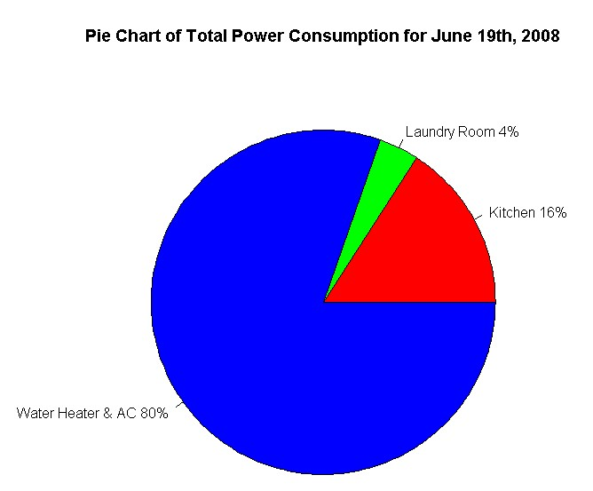
Power Consumption by Specific Date
As mentioned in the previous slide, we again can see just how much temperature regulation contributes to power consumption.
That being said, as we take deeper looks into the data, based on date and time, we start to see major differences in power consumption between the kitchen and the laundry room.
We will continue to see differences in power consumption between these two parts of the house in later slides.
With this in mind, we should consider how might seasonality affect power consumption in the area of consumer electronic usage.

Slide 5
Visualizing differences in power consumption
As mentioned in the previous slide, we will now take a look at how power consumption between the kitchen, the laundry room and the AC & Heater differ at different moments of time.
These visualizations should prompt us to consider how we use different home appliances throughout the day, the week or some other period of time.
Given that these visualizations are very specific, we should think about consumption behavior and habits.
It may not be possible to generate long-term insights regarding power consumption, such as generalizations, when looking at specific visualizations as demonstrated in the following slides. However

Slide 6
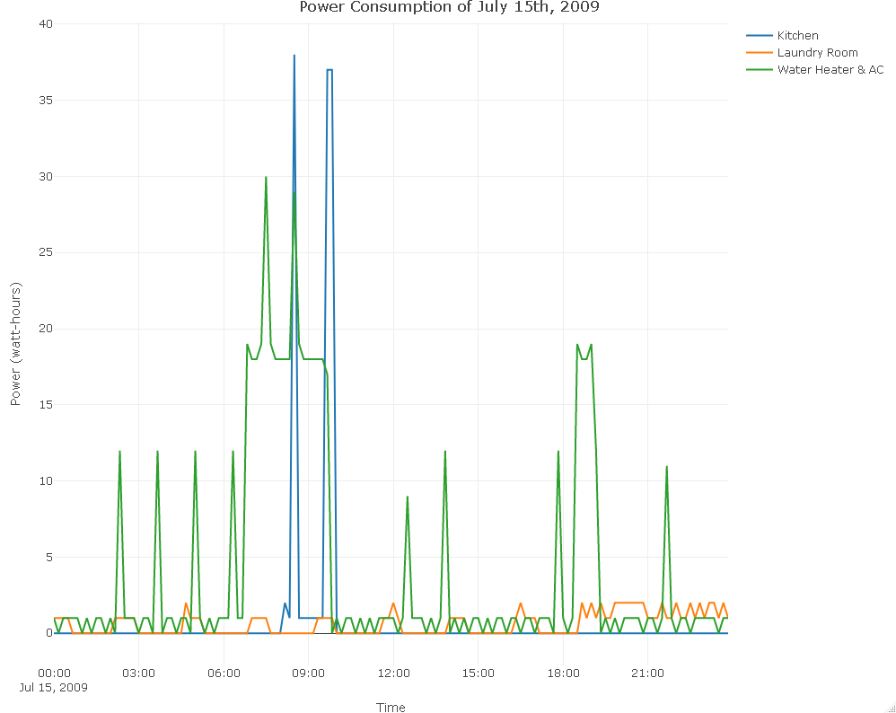
Power Consumption by Day
For July 15th 2009, we can clearly see that power consumption associated with the Water Heater & AC was more consistent and took place throughout the whole day. This is also true for the laundry room (when not in active use).
As for power consumption in the kitchen its use was not consistent and did not took place throughout the whole day.
In the kitchen, power usage spiked only once during the morning time. However, there were two spikes in power consumption, in the morning and night time, for the Water Heater & AC.
This graph may be related to a “typical” work day.

Slide 7
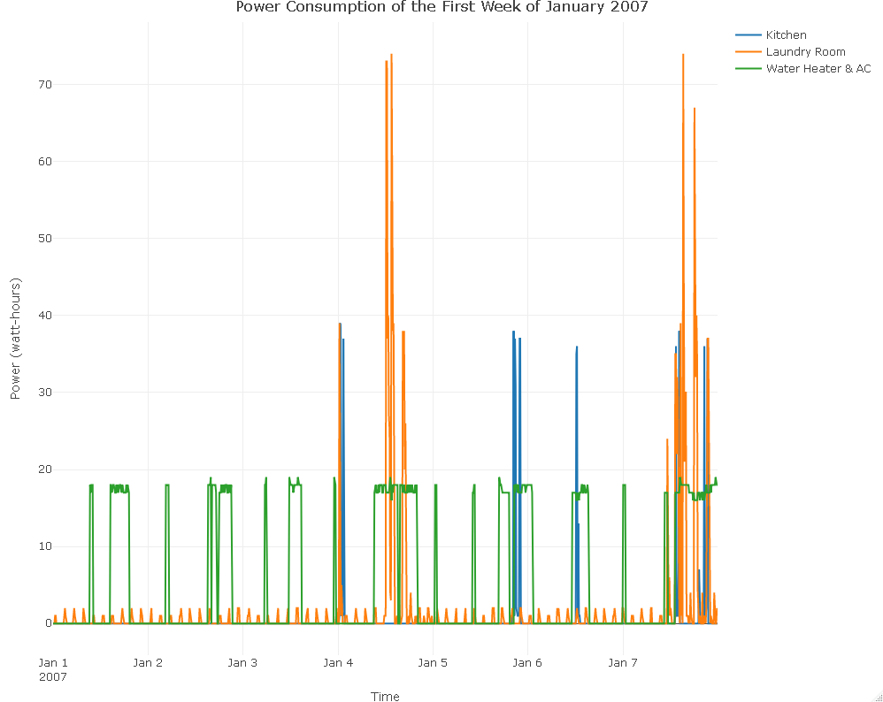
Power Consumption by Week
For the first week of January 2007, we can confirm previous patterns and observe some interesting new patterns.
The major previous pattern that we can see is how consistent the power consumption of the Water Heater & AC is. Throughout the week, it does not appear to change much.
However, we continue to see great difference in power consumption between the kitchen and the laundry room. This time, the two most prominent spikes took place at the laundry room in the middle of the week and end of the week, when in active use. When not in active use, the power consumption of the laundry room was consistent.
As for at the kitchen, power consumption seemed to occur in about three days (Jan 4th – 6th).

Slide 8
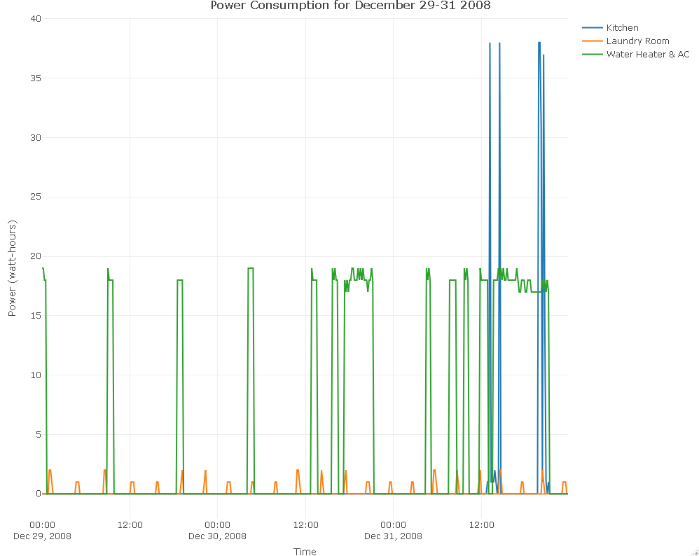
Power Consumption (Time Period)
For the time period of the last three days of December 2008, we can see much of the same patterns as we saw in previous slides.
Firstly, the power consumption of the Water Heater & AC and the laundry room is consistent. As usual, the former area of the house uses far more power than the latter.
However, this time around, power consumption spiked in the kitchen during late at night on December 31st.

Slide 9
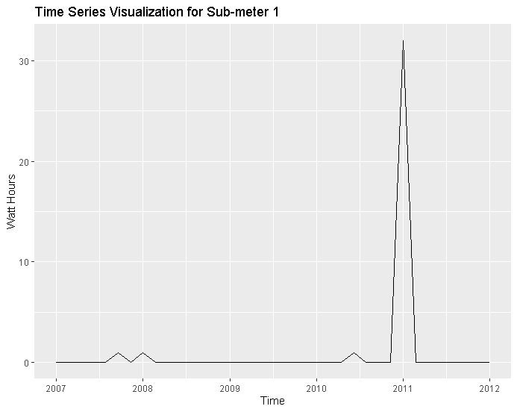
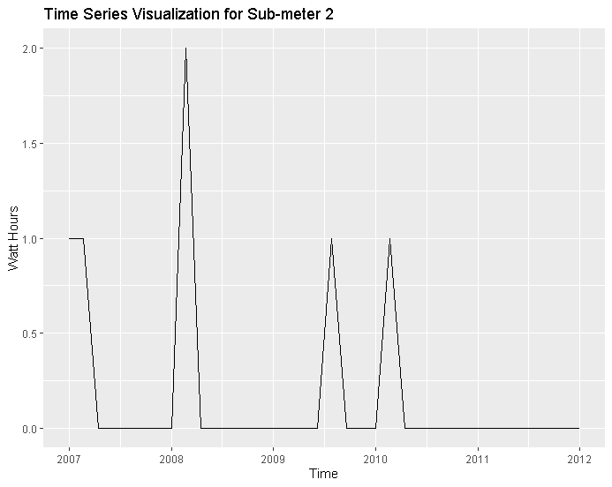
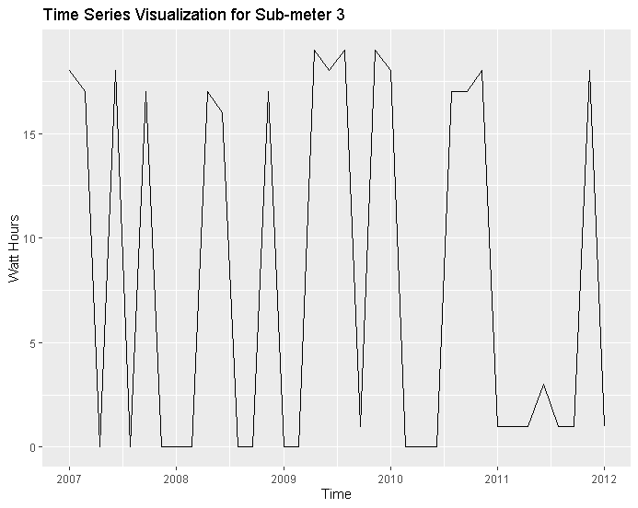
Time Series Visualizations
Time series graphs are special visualizations that show data points at a specific interval across time.
These graphs are helpful because they can help us visualize long-term trends in data.
These graphs further confirm earlier insights, such as that the Water Heater & AC have more consistent power consumption. The kitchen has overall less activity than the laundry room, but its power spikes are larger.

Slide 10
Forecasting Time Series
Forecasting is the process of taking existing date and time data and generating future predictions about the trends of that data.
This is useful for understanding power consumption because we may be able to anticipate future trends.

Slide 11
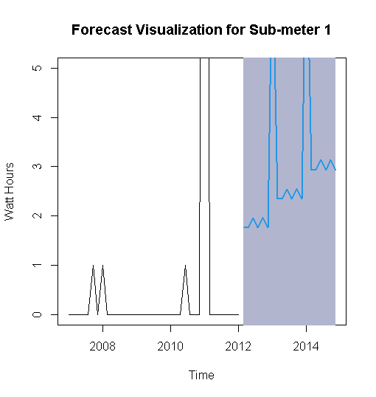
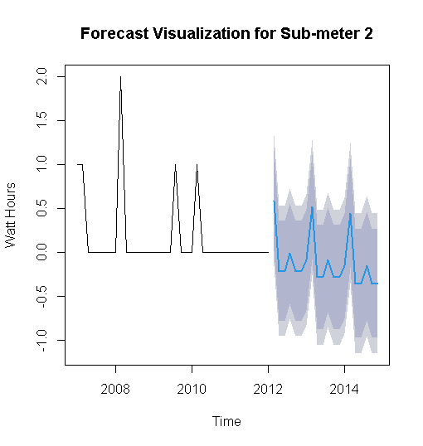
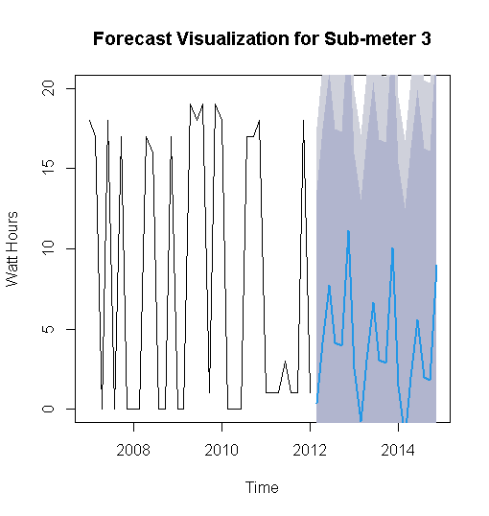
Time Series Visualizations and Model Metrics
Model Metrics for Sub-meter 1 | Model Metrics for Sub-meter 2 | Model Metrics for Sub-meter 3
Multiple R-squared: 0.1758 | Multiple R-squared: 0.4224 | Multiple R-squared: 0.1739
Adjusted R-squared: -0.03022 | Adjusted R-squared: 0.278 | Adjusted R-squared: -0.03268
RMSE: 5.406 | RMSE: 0.38 | RMSE: 8.84

Slide 12
Decomposition Analysis
Decomposition is used to further express what underlying trends may exist in a time series graph.
In the following slide, we can better see underlying trends in composition for each of three parts of the home (represented by sub-meters)
Again, we find that power consumption in the kitchen has periods of non-activity and single peak activity spikes. For the Water Heater & AC, the activity is constant with some ebbs and flows that are generally consistent.

Slide 13
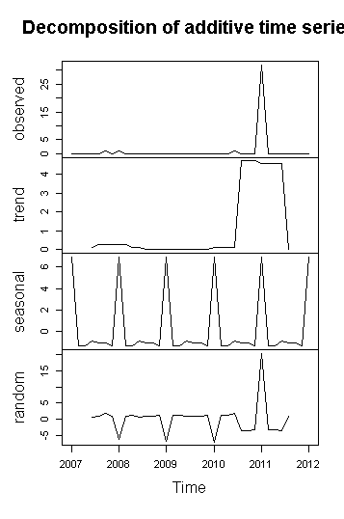
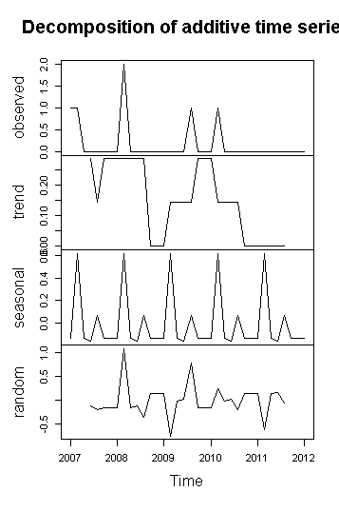
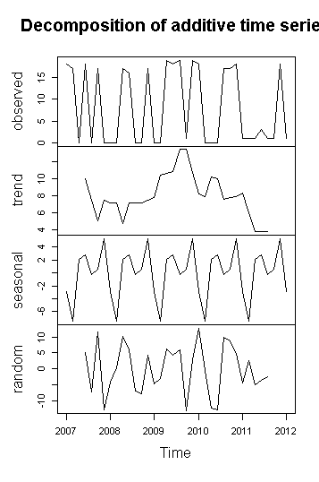
Decomposition Visualizations and Summary Statistics
Sub-meter 1 | Seasonal | Trend | Sub-meter 2 | Seasonal | Trend | Sub-meter 3 | Seasonal | Trend
Minimum | -1.3194 | 0.0000 | Minimum | -0.160204 | 0.0000 | Minimum | -7.47245 | 3.714
1st Quartile | -1.3194 | 0.0000 | 1st Quartile | -0.131633 | 0.0000 | 1st Quartile | -2.93674 | 7.143
Median | -1.0694 | 0.1429 | Median | -0.131633 | 0.1429 | Median | 0.56327 | 7.643
Mean | 0.1925 | 1.1619 | Mean | -0.003657 | 0.1476 | Mean | -0.08158 | 7.986
3rd Quartile | -0.8694 | 0.2857 | 3rd Quartile | 0.068367 | 0.2857 | 3rd Quartile | 2.79184 | 10.000
Maximum | 6.9306 | 4.7143 | Maximum | 0.618367 | 0.2857 | Maximum | 5.27755 | 13.429

Slide 14
Holt Winters Analysis
Holt Winters is a forecasting technique that can visualize underlying trends for date and time data.
An interesting aspect of this type of technique is that its predictive capabilities utilize seasonality.
Additionally, projections are much smoother than other forecasting methods, which may make it easier to determine more generalized predictions.
Given the data, we can see that the projections are much wider for the kitchen and laundry room, which may be related to how they are not always active or aren’t always active in a consistent way.
When we look at the projection for the Water Heater & AC, it appears less narrower. This may be related to how power consumption for these two appliances are generally far more consistent and frequent, which may lead to less overall variation than like that in the kitchen and laundry room.

Slide 15
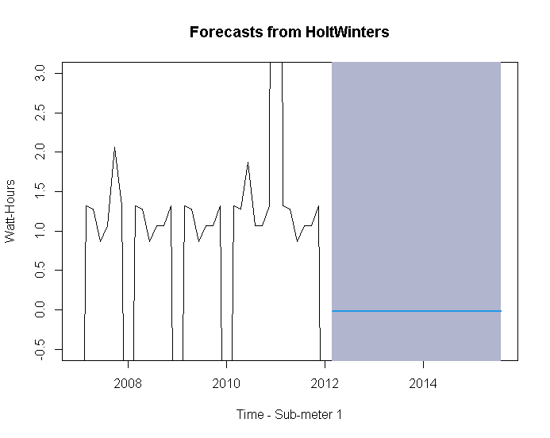
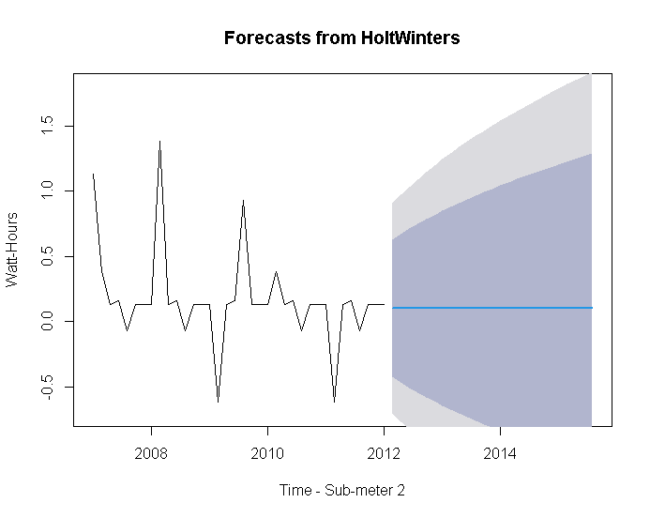
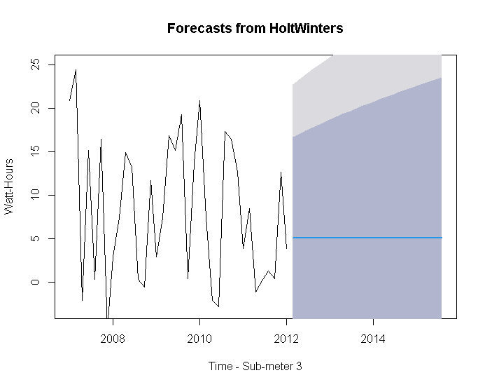
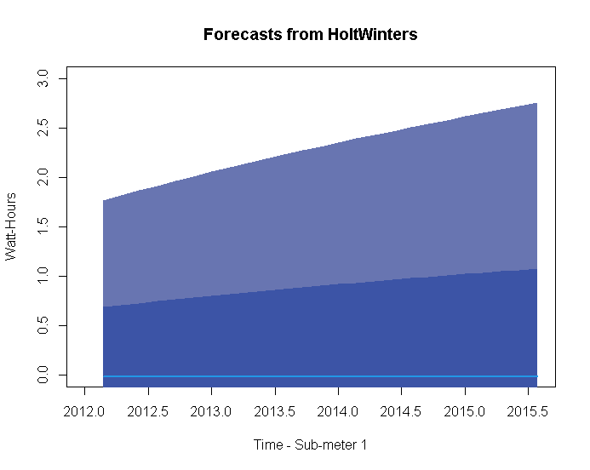
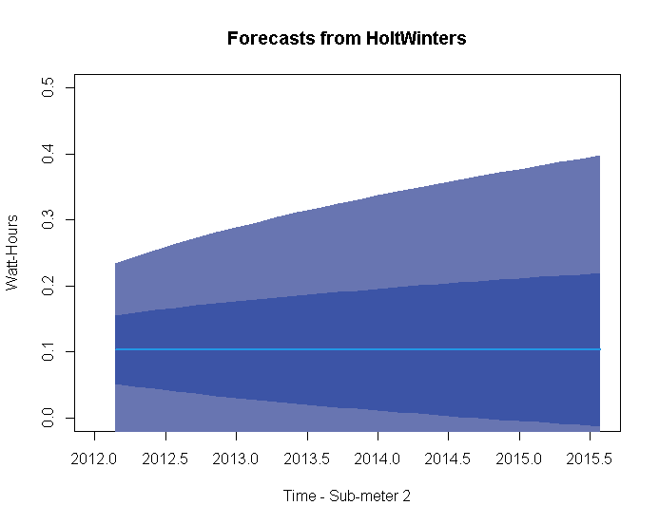
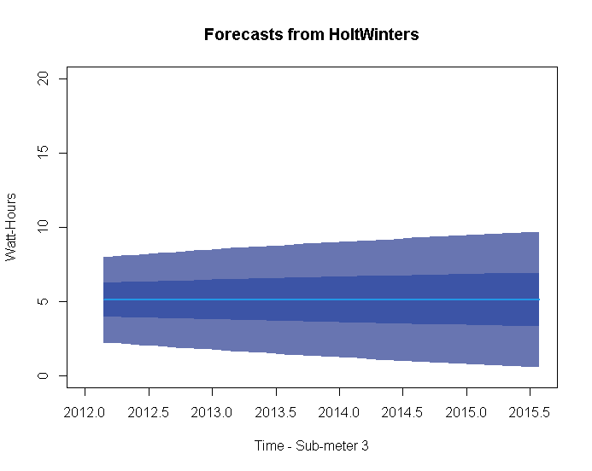
Holt Winters Forecasting Visualizations

Slide 16
Useful correlations or predictions from the data
It appears that the laundry room and Water Heater & AC are always consuming power. The former’s power consumption spikes when its appliances are being used directly (washing/drying clothes).
The latter’s power consumption has less noticeable spikes, consumes more power generally, and appears to be more directly affected by seasonality than the laundry room or the kitchen. More specifically, power consumption is higher during the summer season than the winter season.
The power consumption of the kitchen and laundry room appear less seasonally affected. In general, the kitchen’s spikes in power consumption are not prolonged. They do not last as long as the spikes in the laundry room.

Slide 17
Summary statement
Given our analysis, I believe that the use of Internet of Things technology and Data Analytics are capable of the following:
Helping home owners visualize their power consumption patterns across day, week, month, year and other periods of seasonality.
It is possible to predict future power consumption with some measure of confidence.
However, it is important that additional factors (outside of the scope of the data) may be relevant, such as cost of electricity + travel (not being at home) + changes in energy efficiency over time (difference between newer and older appliances) + etc.

Slide 18
Additional recommendations
1. It would be potentially insightful to know whether or not a home owner travels frequently or not.
2. It would be insightful to know energy costs and whether or not home owners may change their consumption patterns given that.
3. It would be insightful to compare data between newer and older houses, specifically looking to see if energy efficiency of appliances have any bearing on consumption patterns.
4. It would be interesting to see how consumption patterns differ based on geography.
5. It would be interesting to see how consumption patterns differ based on income level, education level or proximity to city centers.

Slide 19
Lessons learned
Throughout this project, we learned the value of filtering date and time data to better interpret trends and patterns in the data (granularity)
We learned the value of properly organizing data so that it can be worked upon with certain techniques in order to generate particular insights (forecasting, time series, etc.)

